Slide 1
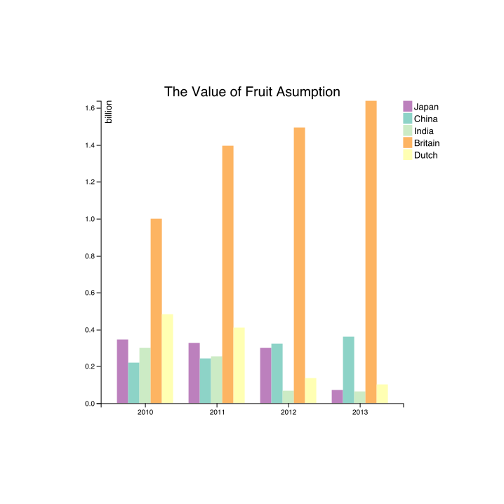
Consumption
Score of Each Country
The Years

Slide 2
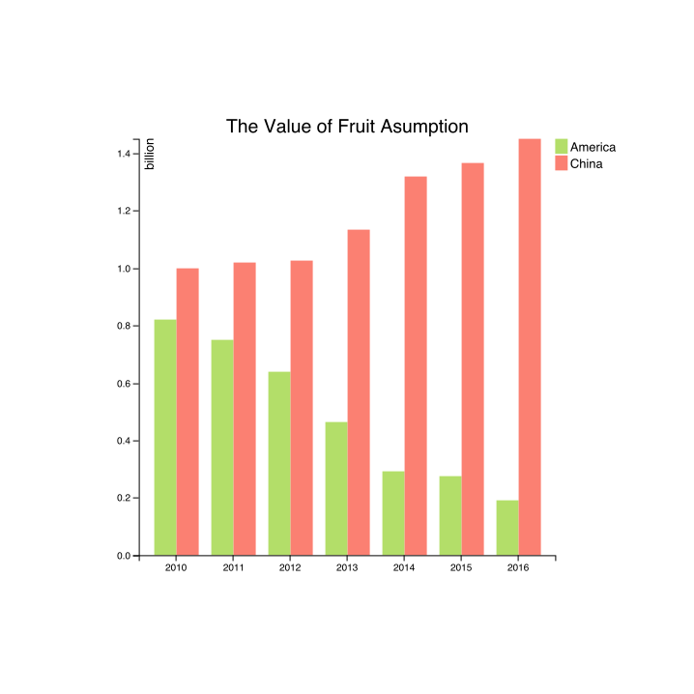
Vegetable Consumption
Consumption (In Millions)
Year

Slide 3
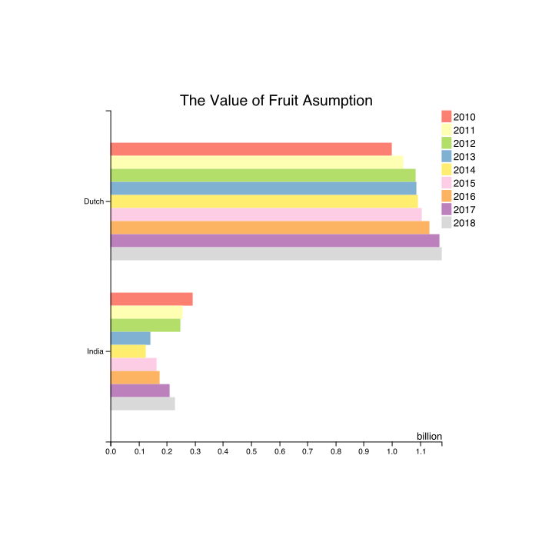
The Score of Each Country
Country
Score

Slide 4
